Slide 2

Shader Profiling and Optimization
Notes:
Good evening, welcome to this presentation on Shader Profiling and Optimization.
First of all, I would like to ask you: who is a programmer? Who is an artist? Who is a game designer?
The reason I ask you this, is because a game, is a visual product, which means, that the players will be sensing them, mostly throght the sight. That’s why we want our games to look as good as possible (on their style) and run as fast as we can make them run.
So, in today-s presentation. I will show you some techniques that can be useful to profile and optimize your shaders in Unity. So, you will walk away with more tools under your belts to create optimized and stunning games.

Slide 3
Arturo Núñez Product Evangelist, Unity Technologies
Notes:
My name is Arturo Nunez, I’m product evangelist at Unity Technologies. Im based in Mexico City.
The topic that we will discuss today is one of my favorites so I hope you enjoy the talk.
Also, I want to thank my colleague Asa Reed and Juan Uran for the help.

Slide 4
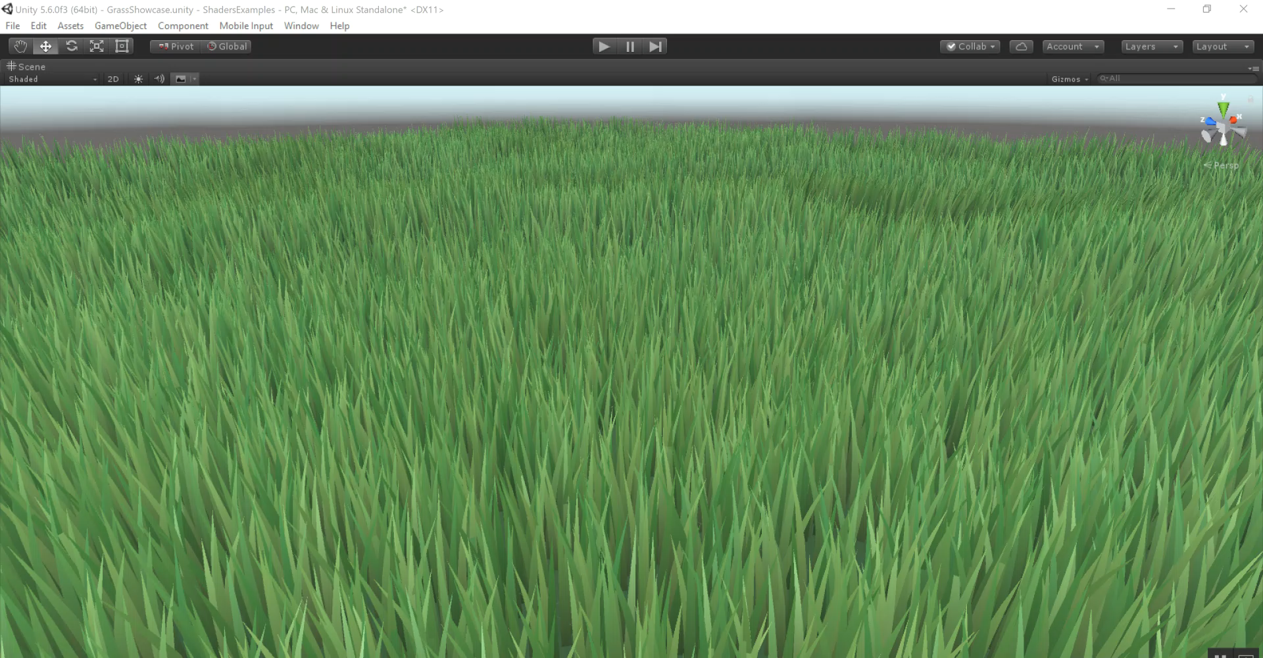
Notes:
So, why do we want to learn how to optimize and profiles? Isn’t Unity Standard Shader already optimized?
And the answer is yes, but at some extent. Probably, for the type of game or visuals that you want to achieve, you will need to find custom ways of optimizing.
For example, if you want to have huge terrains of grass, maybe GPU instancing can be a good idea to implement.

Slide 5
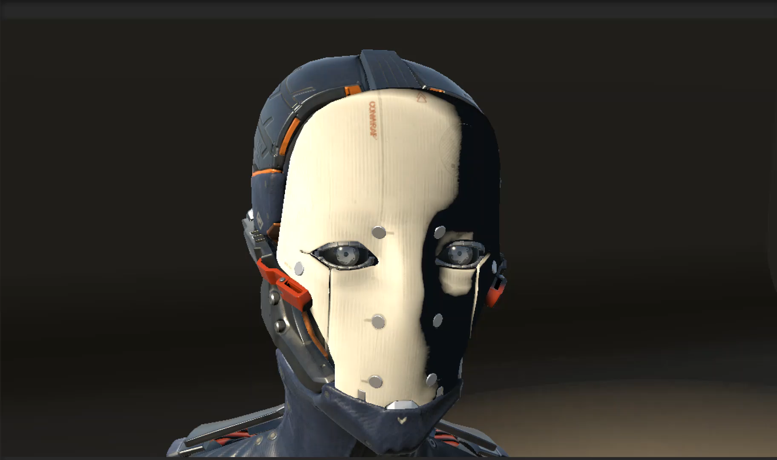
Notes:
Or take this mask as an example. If this effect will be a central part of your games mechanic, might be better to find a way to pre-compute the effect, instead of doing it over and over for each character. But again, depends on your specific use case.

Slide 6
Rendering Pipeline - A Basic Overview
Assets (mesh vertices, textures) sent to GPU
Prepare to Render - Send updated transforms etc. to GPU
Render to FBO - Run Vert/Frag shaders on GPU
Blit Framebuffer to Screen
(Not necessarily done every frame)
(Typically happens every frame)
Notes:
FBO = Frame Buffer Object

Slide 7



Shaders - What is Vertex Shader? Fragment Shader?
Vertex Shaders run on every vertex of every mesh in the Camera frustum
Pixel Shaders run on every pixel that lies inside the visible triangles of your mesh
Vertex Shader
Pixel Shader
Vertex Shader
Pixel Shader
Interpolation and Rasterization
Interpolation and Rasterization

Slide 8
Why do we care about optimizing Shaders?
In general, shaders run EVERY frame on EVERY mesh in your game
Vertex Shaders (VS) operate on every vertex on your mesh
Pixel/Fragment shaders (FS) operate on every pixel within the triangles composed by these vertices
On a per-frame basis, that means there is typically FAR more work done by your shader code than your own game code

Slide 9
Profiling Tools
Notes:
As you can Imagine, profiling the shaders can be a daunting task. Specially If we follow the traditional methos of debugging gameplay code.
For that, we need to use other techniques that allows us find where there is room for optimization. And to optimize, we first need to know what needs to be optimized. Otherwise, we might be trying to fix something that does not need to be fixed.

Slide 10
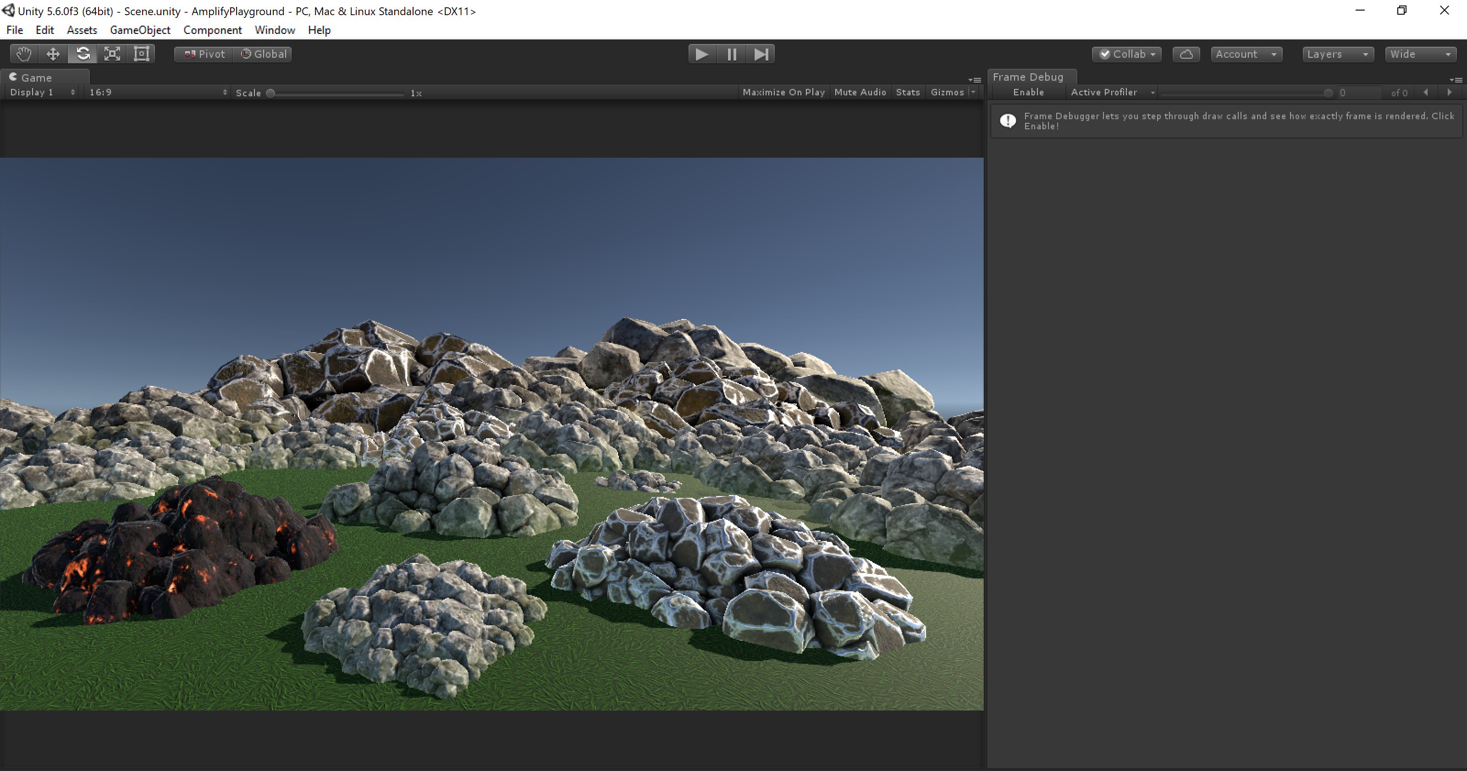
Notes:
Frame Debugger Demo

Slide 11
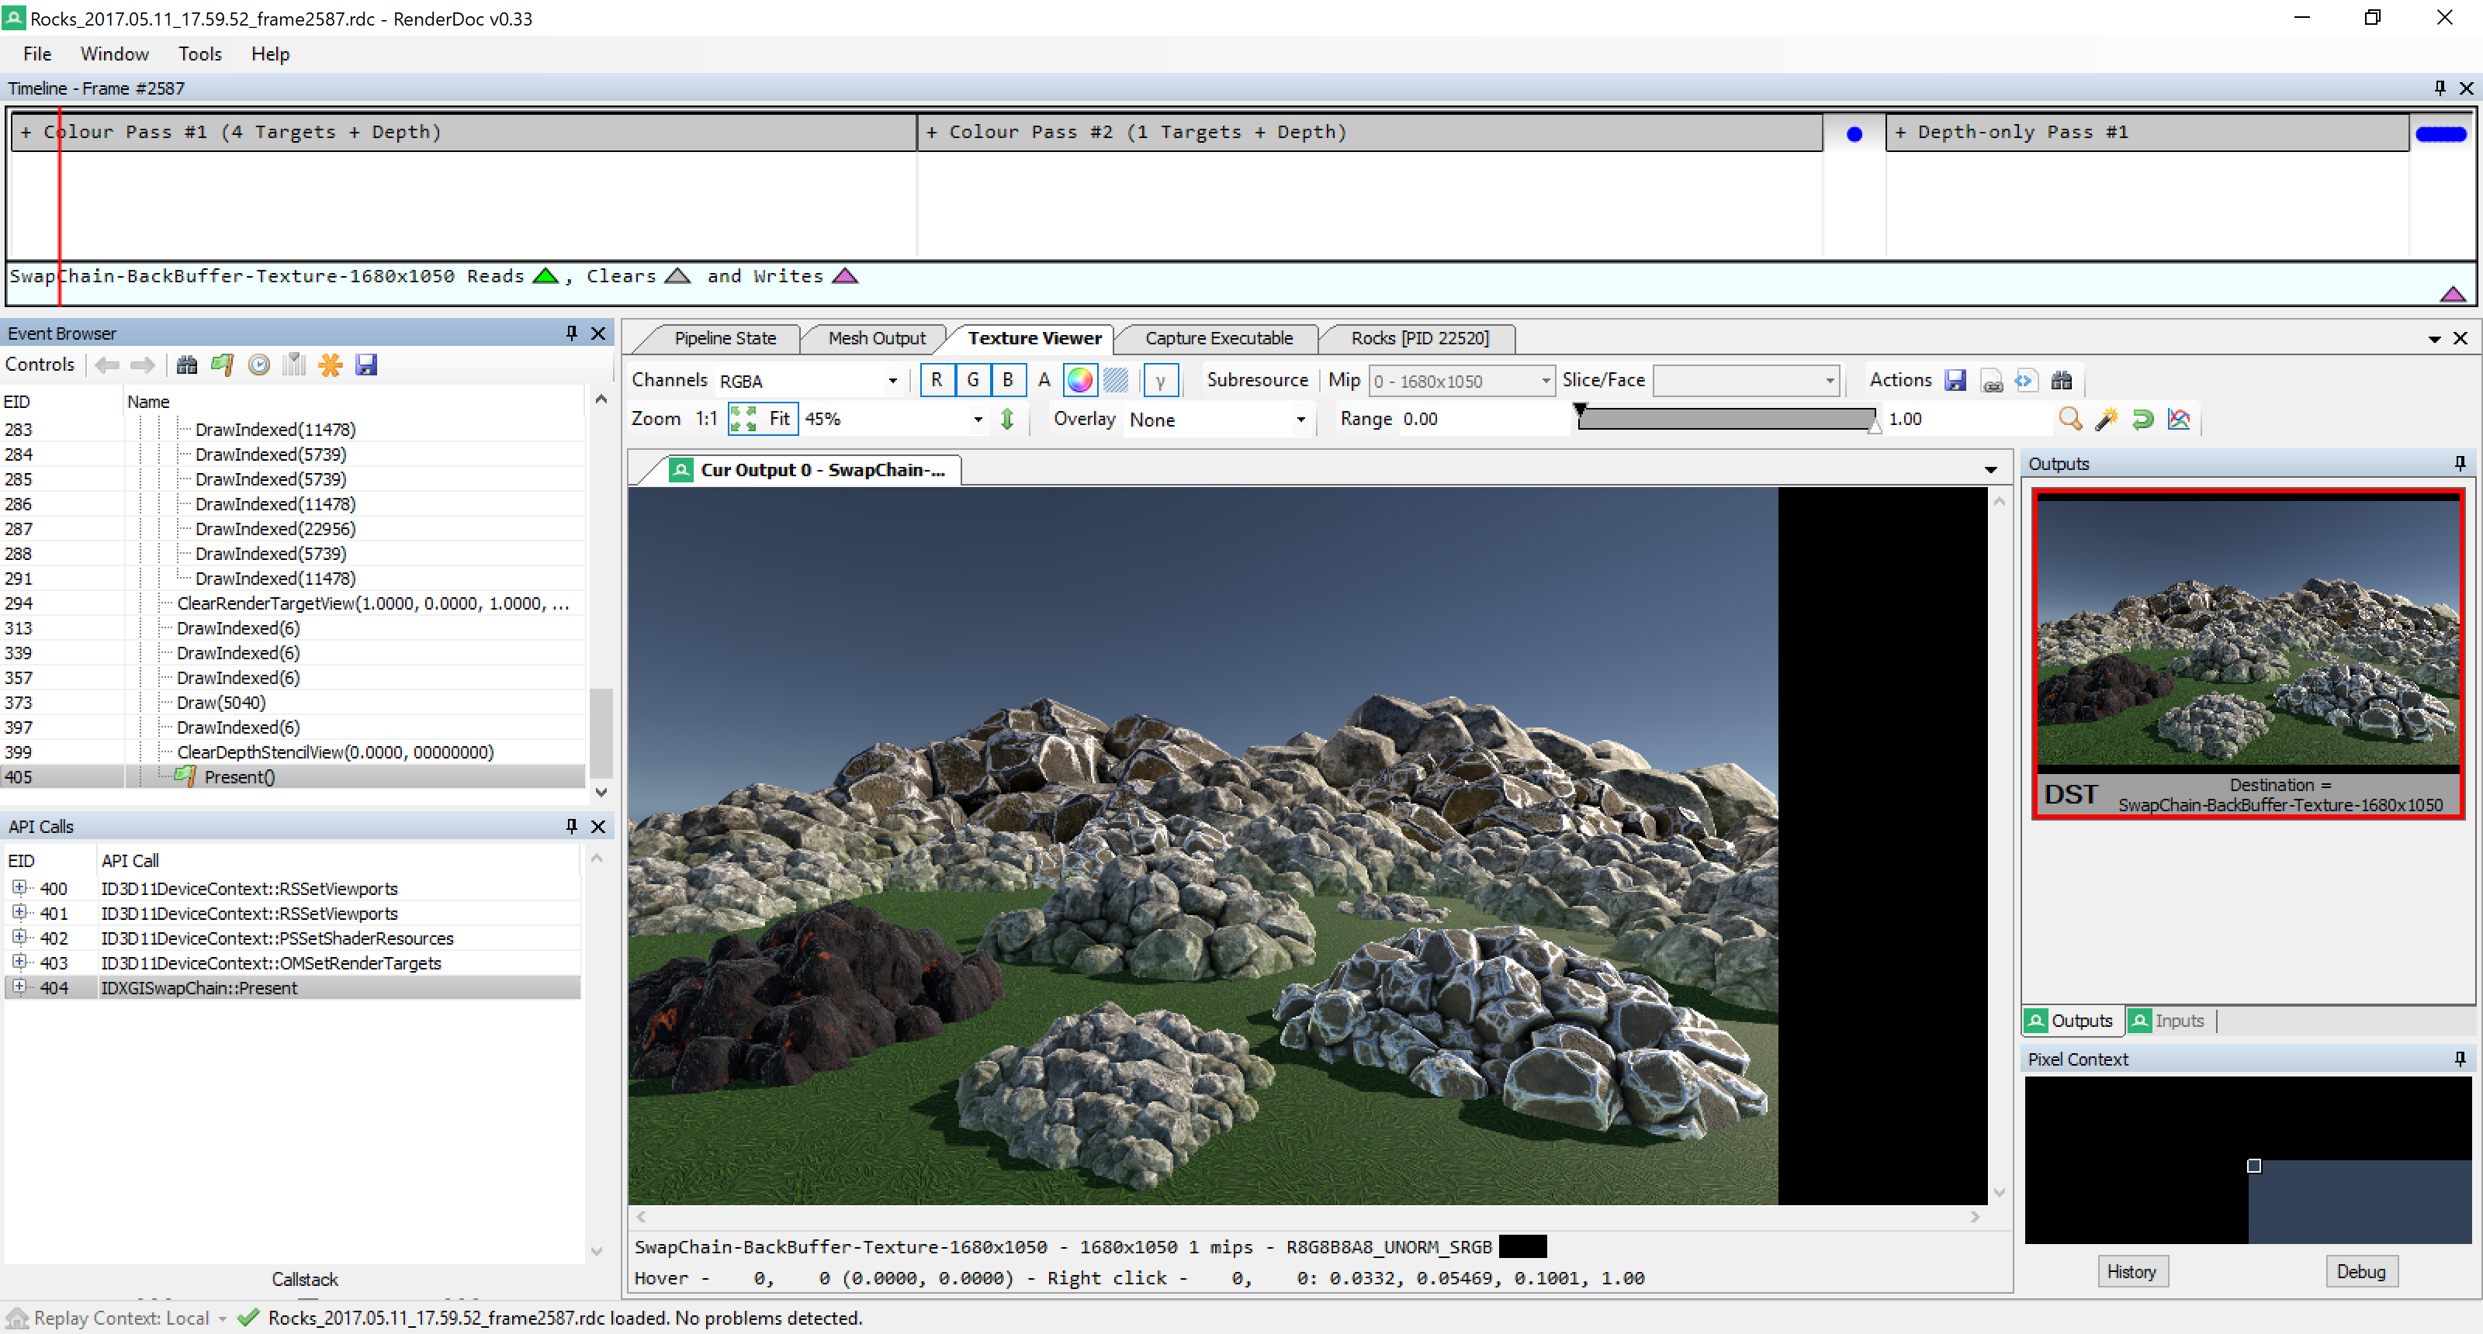
Notes:
Render Doc Demo

Slide 12
More tools
Visual Studio Graphics Diagnostics https://msdn.microsoft.com/en-us/library/hh315751.aspx
NVIDIA PerfHUD https://developer.nvidia.com/nvidia-perfhud
GPU Shader Analizer http://gpuopen.com/archive/gpu-shaderanalyzer/
XCode https://developer.apple.com/xcode/

Slide 13
Best Practices

Slide 14
Computation
Do less non-constant math
vertScale = 10/22;
Use constants or dynamic uniforms
static const fixed4 COLOR_MASK = fixed4(0.5, 0.75, 0.5, 1);

Slide 15
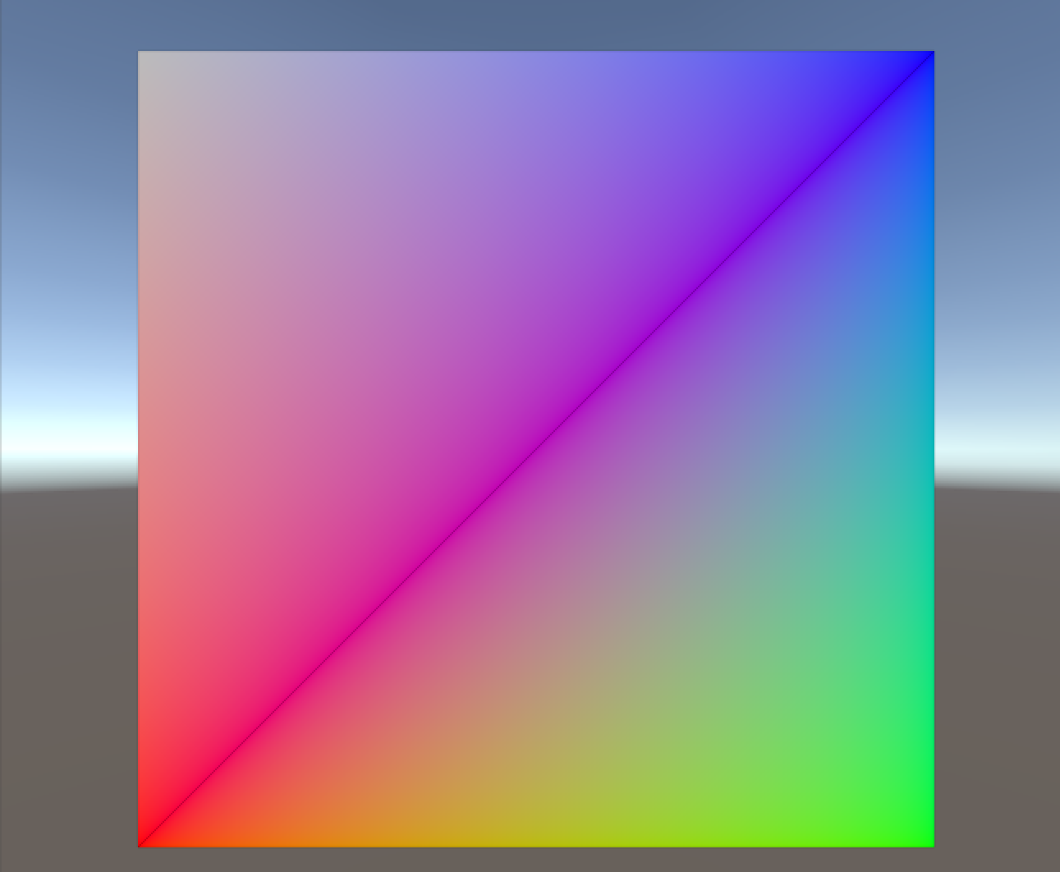
When possible, keep computation on the Vertex Shader

Slide 16
Specify a mask for vector operations
ColorMask RGB | A | 0 | any combination of R, G, B, A
Notes:
Specify a write mask for a vector operation whenever possible (If It doesn’t use all of the components of the result)
Set color channel writing mask. Writing ColorMask 0 turns off rendering to all color channels. Default mode is writing to all channels (RGBA), but for some special effects you might want to leave certain channels unmodified, or disable color writes completely.

Slide 17
Try to avoid branching code
if – else
Loops
Mostly on dynamically set values.
Notes:
Avoid branching based on dynamically set values/non-uniforms (if-else, loops)

Slide 18
WarmUp your Shaders
If you notice performace hiccups, try seeing if warming up your Shaders yield to better results:
WarmupAllShaders();
Or even better, use ShaderVariants

Slide 19
Know your renderer model and hardware!
Make sure you know the impact of operations such as:
Discard()*
Floor()
For instanc on OpenGL 2, OpenGL ES, etc.
Notes:
Check the impact of operations (such as discard(), floor() etc.) on your renderer model (OpenGL 2, OpenGL 3, OpenGL ES, etc.) and hardware!

Slide 20
Minimize texture fetches
fixed4 col = tex2D(_MainTex, i.uv);
o.Emission = texCUBE (_Cube, IN.worldRefl).rgb;
Notes:
Minimize texture fetches (tex2D, texCUBE etc.)
If you are reading a texture more than once, cache the value.

Slide 21
Use ShaderLab’s blending
Instead of manually blend with alpha:
Blend SrcAlpha OneMinusSrcAlpha // Traditional transparency
Blend One OneMinusSrcAlpha // Premultiplied transparency
Blend One One // Additive
Blend OneMinusDstColor One // Soft Additive
Blend DstColor Zero // Multiplicative
Blend DstColor SrcColor // 2x Multiplicative
Notes:
Use Unity’s ShaderLab blending instead of trying to manually blend with alpha (https://docs.unity3d.com/Manual/SL-Blend.html)

Slide 22
Use MaterialPropertyBlock
Is faster to set properties using a MaterialPropertyBlock rather than
material.SetFloat();
Material.SetColor();
Notes:
Use MaterialPropertyBlock instead of material.SetFloat()/SetColor() etc.

Slide 23
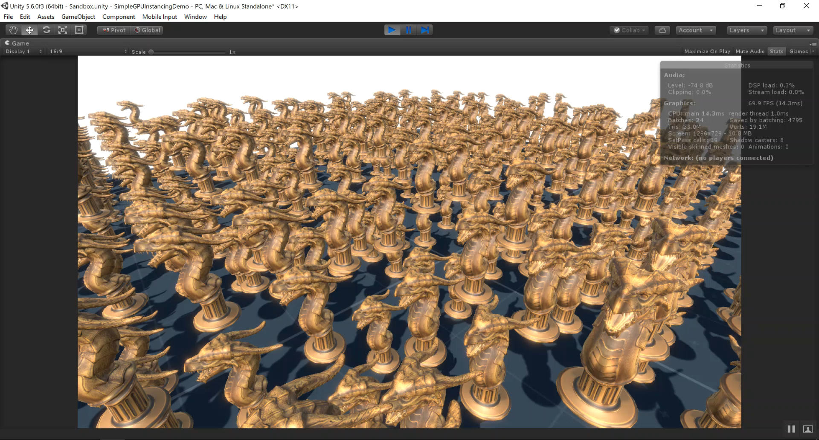
Use GPU Instancing
62 FPS
22 Batches
4705 Saved Batches
Notes:
Use GPU instancing (5.4 req. - https://docs.unity3d.com/Manual/GPUInstancing.html) or static/dynamic batching when the same mesh is rendered multiple times per frame

Slide 24
Keep the math functions in Shader code to a minimum
For example:
pow()
exp()
cos()
log()
Consider using pre-calculated lookup textures.
Notes:
Avoid expensive math functions in shader code (pow, exp, log, cos, sin, tan, etc). Consider using pre-calculated lookup textures instead.

Slide 25
Select lowest possible precision
From higher precision to lower:
float
half
fixed
int
Notes:
Pick lowest possible number precision format (float, half, fixedin Cg) for best performance.

Slide 26
Swizzling for multi-component calculations
Prefer to do …
pos.xy *= 0.5;
Over …
pos.x *= 0.5;
pos.y *= 0.5;
Notes:
Use swizzling for multi-component calculations (pos.xy *= .2; vs pos.x *= .2; pos.y *= .2;)

Slide 27
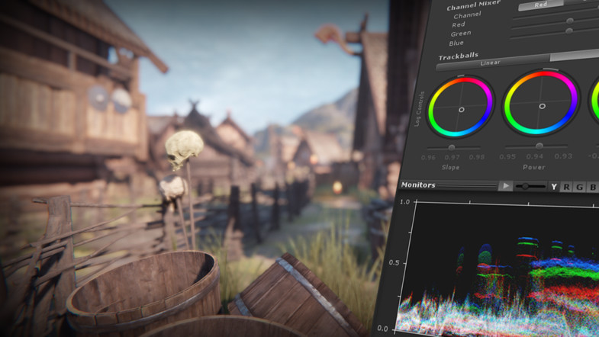
For Post Processing
Take a look at Unity’s post processing stack.
https://www.assetstore.unity3d.com/en/#!/content/83912

Slide 28
References
Project and presentation: https://github.com/ArturoNereu/ShaderProfilingAndOptimization
Unity Frame Debugger https://docs.unity3d.com/Manual/FrameDebugger.html
Optimizing Graphics Performance: https://docs.unity3d.com/Manual/OptimizingGraphicsPerformance.html
RenderDoc: https://github.com/baldurk/renderdoc

Slide 29
谢谢

